Slide 1
Artificial Intelligence CS-511
Modified slides of Prof. M. Batouche, KSU, and AI course on Udacity.

Slide 2
Uninformed Search

Slide 3
Basic Search Algorithms
Uninformed (Blind) search: breadth-first, depth-first, depth limited, iterative deepening.

Slide 4
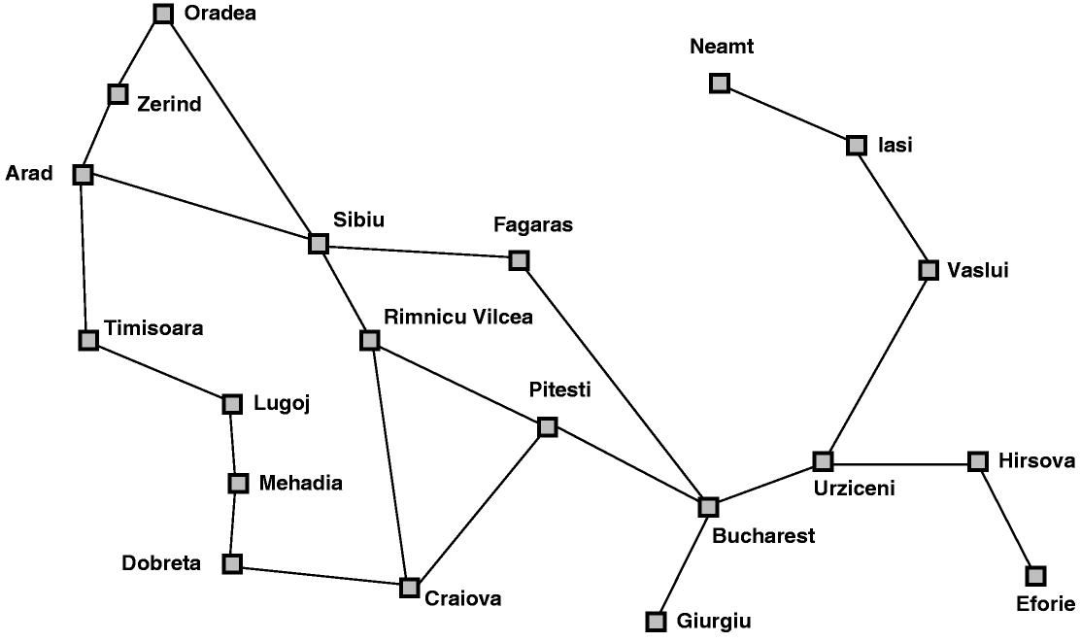
Map searching (navigation)

Slide 5
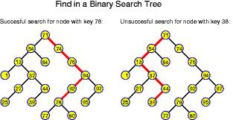
Linking Search to Trees and Graphs
You can begin to visualize the concept of a graph
Searching along different paths of the graph until you reach the solution
The nodes can be considered congruous to the states
The whole graph can be the state space
The links can be congruous to the actions……

Slide 6
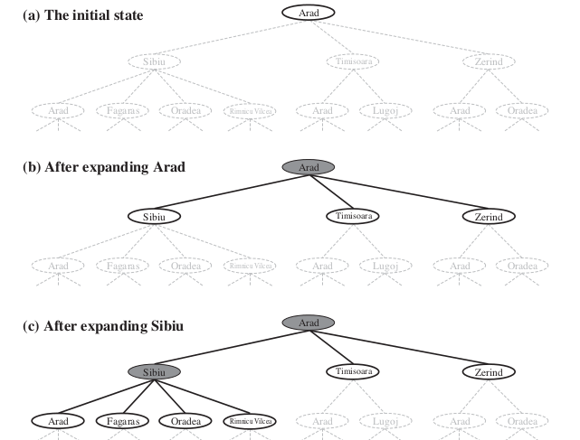
Tree search example

Slide 7
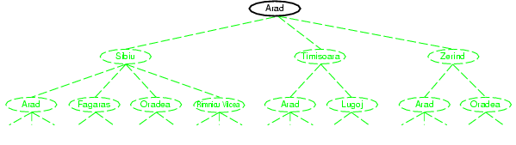
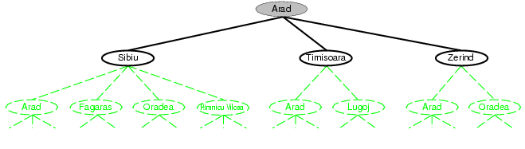
Fringe
Fringe: The collection of nodes that have been generated but not yet expanded
Each element of the fringe is a leaf node, with (currently) no successors in the tree
The search strategy defines which element to choose from the fringe
fringe
fringe

Slide 8
Queue Functions
The fringe is implemented as a queue
MAKE_QUEUE(element,…): makes a queue with the given elements
EMPTY?(queue): checks whether queue is empty
FIRST(queue): returns 1st element of queue
REMOVE_FIRST(queue): returns FIRST(queue) and removes it from queue a.k.a pop(queue)
INSERT(element, queue): add element to queue a.k.a. push(element,queue)
INSERT_ALL(elements,queue): adds the set elements to queue and return the resulting queue

Slide 9
Search Strategies
A search strategy is defined by picking the order of node expansion
Strategies are evaluated along the following dimensions:
Completeness: Does it always find a solution if one exists?
Optimality: Does it always find a least-cost solution?
Time Complexity: How long does it take to find a solution. Number of nodes generated.
Space Complexity: Maximum number of nodes in memory

Slide 10
Time and Space Complexity ?
Time and space complexity are measured in terms of:
The (effective) branching factor b:
Maximum no. of successors of any node
The average number of new nodes we create when expanding a new node
Depth d: Depth of the shallowest goal node
The length of a path to a goal.
m: The maximum length of any path in the state space.

Slide 11
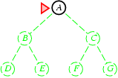
Breadth-first search
Expand shallowest unexpanded node
Implementation:
fringe is a FIFO queue, i.e., new successors go at end

Slide 12
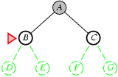
Breadth-first search
Expand shallowest unexpanded node
Implementation:
fringe is a FIFO queue, i.e., new successors go at end

Slide 13
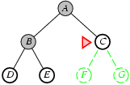
Breadth-first search
Expand shallowest unexpanded node
Implementation:
fringe is a FIFO queue, i.e., new successors go at end

Slide 14
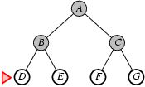
Breadth-first search
Expand shallowest unexpanded node
Implementation:
fringe is a FIFO queue, i.e., new successors go at end

Slide 15
Queue q = new LinkedList();
q.add (this.rootNode);
printNode(this.rootNode);
rootNode.visited=true;
while(!q.isEmpty())
{
Node n=(Node)q.remove();
Node child=null;
while((child=getUnvisitedChildNode(n))!=null)
{
child.visited=true;
printNode(child);
q.add(child);
}
}

Slide 16
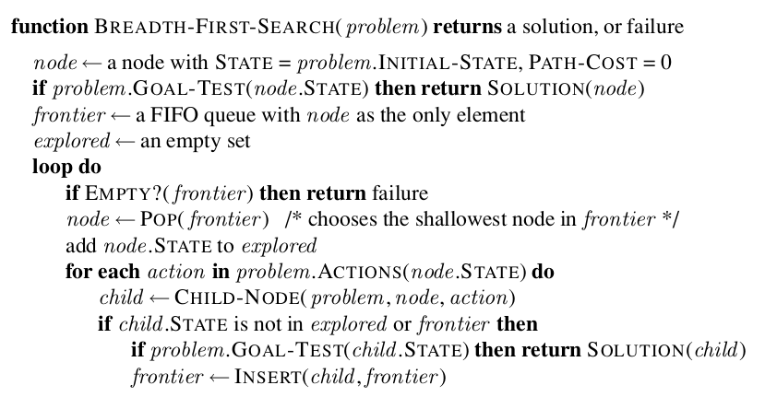
Breadth-first search

Slide 17
Properties of Breadth-first search
Complete? Yes (if b is finite)
Time? b⁰+b¹+b²+b³+… +b^{d} = O(b^{d})
i.e. exponential in d
Space? O(b^{d}) (keeps every node in memory)
Optimal? Yes (if cost = 1 per step)
Space is a big problem: exponential expansion

Slide 18
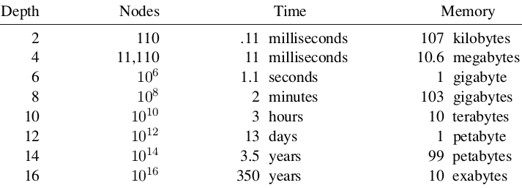
Exponential Expansion Example
The table assumes that 1 million nodes can be generated per second and that a node requires 1000 bytes of storage.
Many search problems fit roughly within these assumptions (give or take a factor of 100) when run on a modern personal computer.

Slide 19
Breadth-first search: two lessons
The memory requirements are a bigger problem than is the execution time
One might wait 13 days for the solution to an important problem with search depth 12, but no personal computer has the petabyte of memory it would take.
Time is still a major factor
a solution at depth 16, (given our assumptions) it will take about 350 years for breadth-first search (or indeed any uninformed search) to find it.
Uninformed methods can solve the exponential complexity search problems only for smallest instances

Slide 20
Uniform Cost Search (UCS)
A
5
2
[5]
B
C
[2]
1
4
1
7
D
[6]
[3]
F
G
[9]
[9]
E
Goal state
4
5
[x] = g(n)
path cost of node n
[7]
H
I
[8]

Slide 21
Uniform Cost Search (UCS)
A
5
2
[5]
B
C
[2]

Slide 22
Uniform Cost Search (UCS)
A
5
2
[5]
B
C
[2]
1
7
[3]
F
G
[9]

Slide 23
Uniform Cost Search (UCS)
A
5
2
[5]
B
C
[2]
1
7
[3]
F
G
[9]
4
5
[7]
H
I
[8]

Slide 24
Uniform Cost Search (UCS)
A
5
2
5
2
[2]
[5]
B
C
[2]
[5]
1
4
1
1
7
7
D
[6]
[3]
F
G
[9]
[3]
[9]
[9]
E
4
5
4
5
[7]
H
I
[8]
[7]
[8]

Slide 25
Uniform Cost Search (UCS)
A
5
2
5
5
2
2
[2]
[2]
[5]
B
C
[2]
[5]
[5]
Goal state path cost g(n)=[6]
1
1
4
1
4
1
1
7
7
7
D
[3]
F
G
[9]
[3]
[3]
[9]
[9]
[9]
[9]
E
4
5
4
4
5
5
[7]
H
I
[8]
[7]
[7]
[8]
[8]

Slide 26
Uniform Cost Search (UCS)
A
5
2
5
5
2
2
[2]
[2]
[5]
B
C
[2]
[5]
[5]
1
1
4
1
4
1
1
7
7
7
D
[6]
[3]
F
G
[9]
[6]
[3]
[3]
[9]
[9]
[9]
[9]
E
4
5
4
4
5
5
[7]
H
I
[8]
[7]
[7]
[8]
[8]

Slide 27
Insert the root into the queue
While the queue is not empty
Dequeue the element having min cost from the queue
(If costs are same, then path could be chosen left to right)
If the path is ending in the goal state
Print the path and exit
Else
Insert all the children of the dequeued element,
with the cumulative costs as cost

Slide 28
procedure UniformCostSearch(Tree, root, goal)
node := root, cost = 0
frontier := priority queue containing node only
explored := empty set
do
if frontier is empty return failure
node := frontier.pop()
if node is goal return solution
explored.add(node)
for each of node's children n
if n is not in explored
if n is not in frontier
frontier.add(n)
else if n is in frontier with higher cost
replace existing node with n

Slide 29
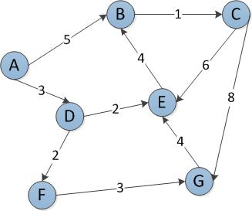
Start Node: A
Goal Node: G
Step Frontier Expand[*] Explored: a set of nodes
1 {(A,0)} A ∅
2 {(A-D,3),(A-B,5)} D {A}
3 {(A-B,5),(A-D-E,5),(A-D-F,5)} B {A,D}
4 {(A-D-E,5),(A-D-F,5),(A-B-C,6)} E {A,D,B}
5 {(A-D-F,5),(A-B-C,6)}[*] F {A,D,B,E}
6 {(A-B-C,6),(A-D-F-G,8)} C {A,D,B,E,F}
7 (A-D-F-G,8)} G {A,D,B,E,F,C}
8 ∅
Found the path: A -> D -> F -> G.
*B is not added to the frontier because it is found in the explored set.

Slide 30
Uniform Cost Search (UCS)
For any step-cost function, Uniform Cost search expands the node n with the lowest path cost.
Implementation:
fringe = queue ordered by path cost, lowest first
UCS takes into account the total cost: g(n).
UCS is guided by path costs rather than depths. Nodes are ordered according to their path cost.
Equivalent to breadth-first if step costs all equal

Slide 31
Uniform Cost Search (UCS)
Complete?
Yes.
Optimal?
Yes, if step cost ≥ small positive constant epsilon
Time Complexity:
O(ceiling (b^{C*/epsilon} )) ~ O(b^{C*})
where C* is the cost of the optimal solution
Space Complexity:
O(ceiling (b^{C*/epsilon} )) ~ O(b^{C*})
where C∗ is the cost of the optimal solution

Slide 32
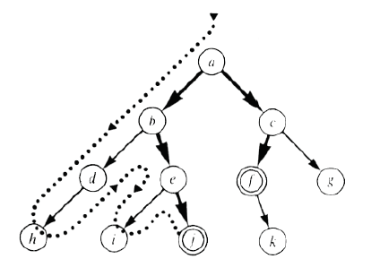
Depth First Search (DFS)

Slide 33
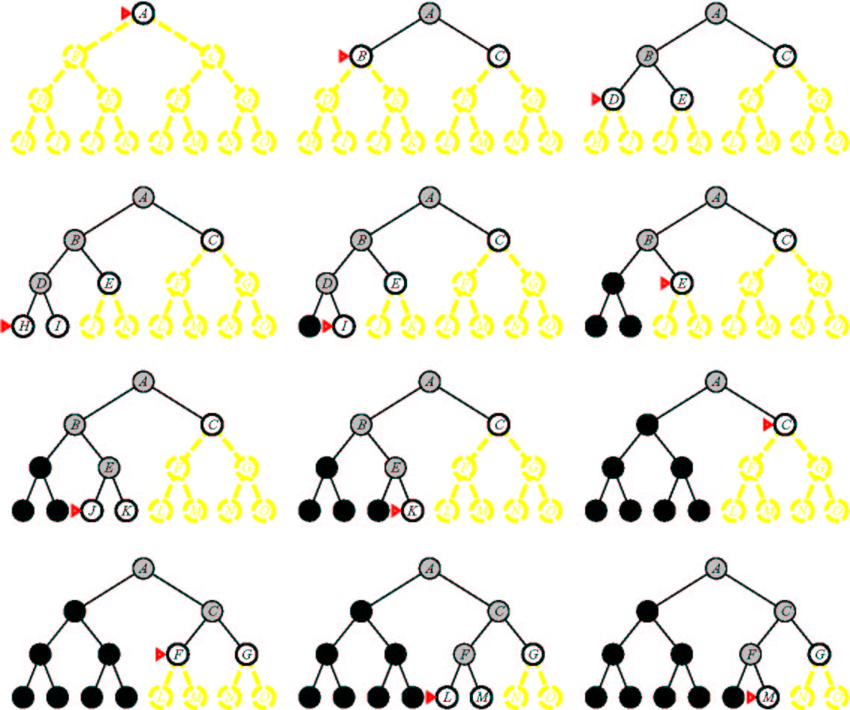
Depth First Search

Slide 34
Depth First Search (DFS)
Main idea: Expand node at the deepest level (breaking ties left to right).
Implementation: use of a Last-In-First-Out queue or stack(LIFO). Enqueue nodes in LIFO (last-in, first-out) order.
Complete? No: fails in infinite-depth spaces, spaces with loops
Complete in finite spaces
Optimal? No
Time? O(b^{m}): terrible if m is much larger than d
Space? O(bm), i.e., linear space!

Slide 35
Start Node: A
Goal Node: G
Step Frontier Expand[*] Explored: a set of nodes
1 {A} A ∅
2 {(A-B),(A-C)} B {A}
3 {(A-B-D),(A-B-E),(A-C)} D {A,B}
4 {(A-B-E),(A-C)} E {A,B,D}
5 {(A-C)} C {A,B,D,E}
6 {(A-C-F),(A-C-G)} F {A,B,D,E,C}
7 (A-C-G)} G {A,D,B,E,C,F,G}
8 ∅
Found the path: A -> C -> G.
*B is not added to the frontier because it is found in the explored set.

Slide 36
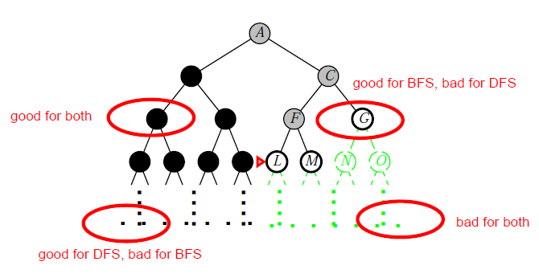
BFS or DFS

Slide 37

Depth-Limited Search (DLS)
Depth Bound = 3

Slide 38
Depth-Limited Search (DLS)
It is simply DFS with a depth bound.
Searching is not permitted beyond the depth bound.
Works well if we know what the depth of the solution is.
Termination is guaranteed.
If the solution is beneath the depth bound, the search cannot find the goal (hence this search algorithm is incomplete).
Otherwise use Iterative deepening search (IDS).

Slide 39
Depth-Limited Search (DLS)
Main idea: Expand node at the deepest level, but limit depth to L.
Implementation:
Enqueue nodes in LIFO (last-in, first-out) order. But limit depth to L
Complete? Yes if there is a goal state at a depth less than L
Optimal? No
Time Complexity: O(b^{L}), where L is the cutoff.
Space Complexity: O(bL), where L is the cutoff.

Slide 40
Iterative Deepening Search (IDS)
function ITERATIVE-DEEPENING-SEARCH():
for depth = 0 to d do
if DEPTH-LIMITED-SEARCH(depth) succeeds
then return its result
end
return failure

Slide 41
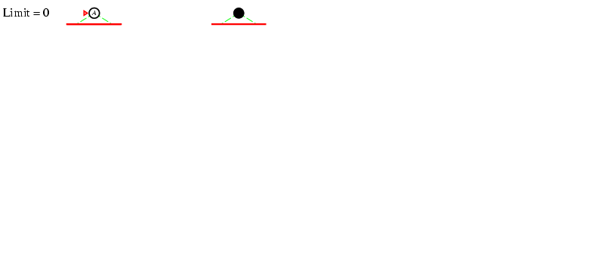
Iterative deepening search l =0

Slide 42
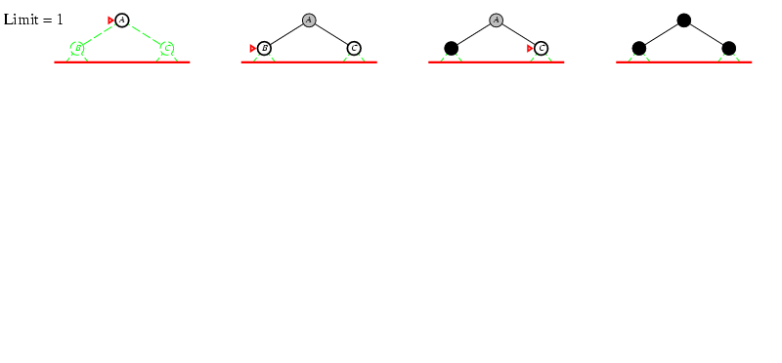
Iterative deepening search l =1

Slide 43
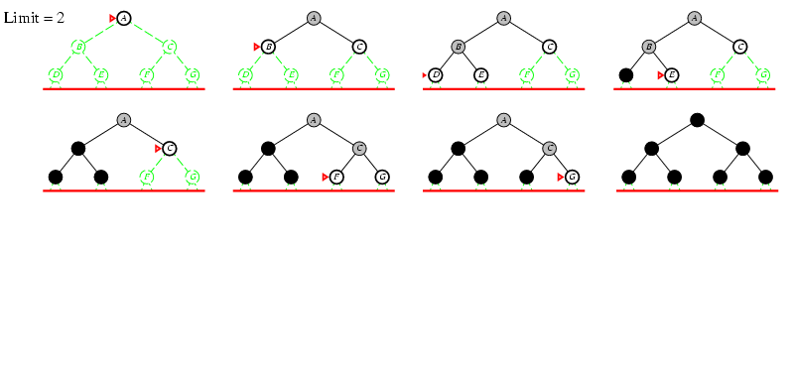
Iterative deepening search l =2

Slide 44
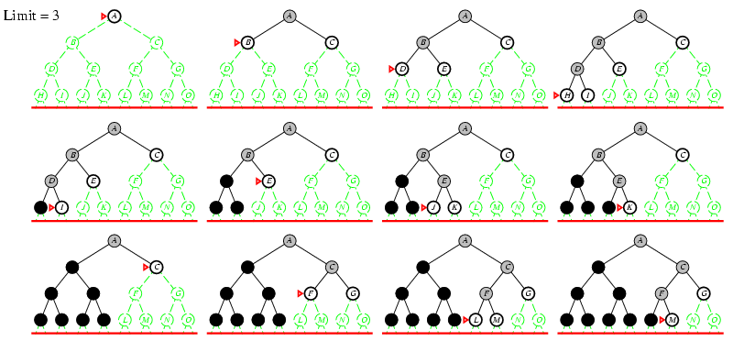
Iterative deepening search l =3

Slide 45
Properties of iterative deepening search
Complete? Yes
Time? O(b^{d})
Space? O(bd)
Optimal? Yes, if step cost = 1

Slide 46
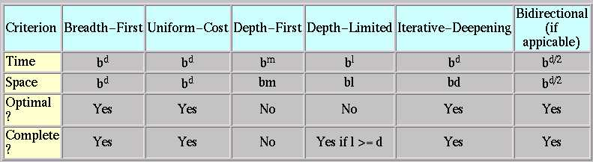
Summary of Algorithms
b: Branching factor
d: Depth of solution
m: Maximum depth
l : Depth Limit

Slide 47

Questions

